Slide 1
Tutorial of STA4002 Multivariate Techniques with Business Applications
Instructor: Dr.Lyu （吕伯君）
Teaching Assistant: Zhou Yanan （周亚楠）

Slide 2
Lecture Time ：Tue & Thu 13:30 - 14:50;
Zhi Xin Bldg 102.
Tutorial Time：Wed 18:00 - 18:50 & 20:00 - 20:50;
Teaching C Bldg 115.
Office hour： Wed 09:00 - 12:00 or by appointments;
Teaching D Bldg 207.
Email：115010302@link.cuhk.edu.cn or yananzhou@link.cuhk.edu.cn

Slide 3
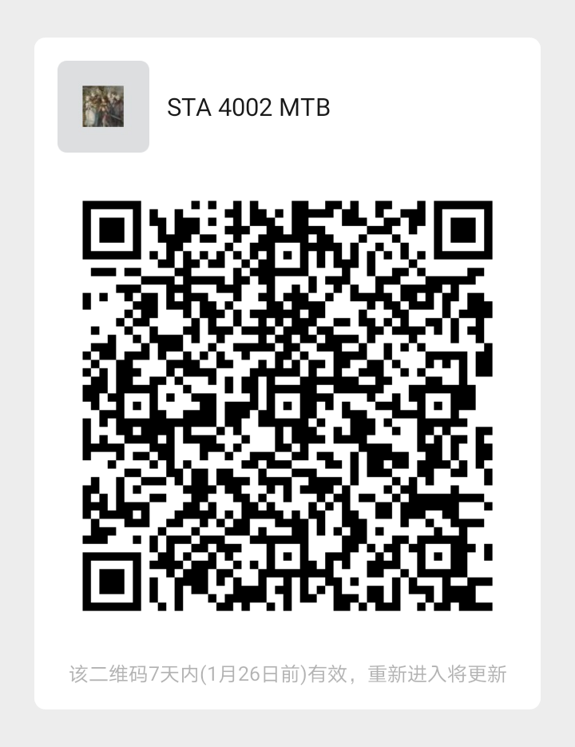
Zoom Link:
Meeting Room：699 168 3237
Meeting Password：540120
Wechat Group
https://cuhk-edu-cn.zoom.com.cn/j/6991683237?pwd=ZlhNb2d6VzNQNlJZZmR1KythOC9aZz09

